Slide 1
Hidden Markov Model with Viterbi Algorithm

Slide 2

Viterbi algorithm
The purpose of the Viterbi algorithm is to make an inference based on a trained model and some observed data.
It works by asking a question: given the trained parameter matrices (transition and emission probabilities, initial probabilities) and data, what is the choice of states such that the joint probability reaches maximum?
In other words, what is the most likely choice given the data and the trained model?
This statement can be visualized as the following formula, and obviously, the answer depends on the data!
this says to find the states that maximize the conditional probability of states given data.

Slide 3
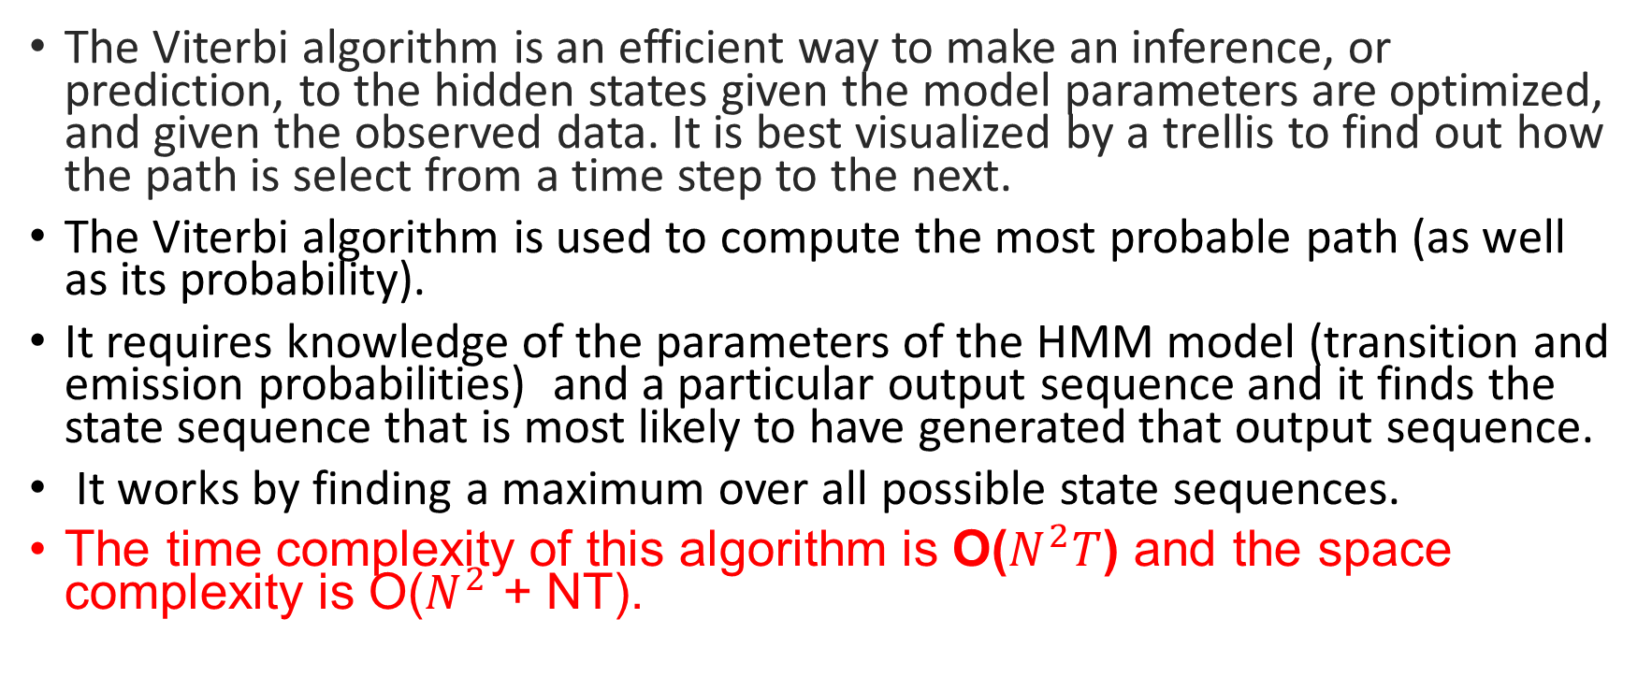
The Viterbi algorithm is an efficient way to make an inference, or prediction, to the hidden states given the model parameters are optimized, and given the observed data. It is best visualized by a trellis to find out how the path is select from a time step to the next.
The Viterbi algorithm is used to compute the most probable path (as well as its probability).
It requires knowledge of the parameters of the HMM model (transition and emission probabilities) and a particular output sequence and it finds the state sequence that is most likely to have generated that output sequence.
It works by finding a maximum over all possible state sequences.
The time complexity of this algorithm is O($N^{2}T$) and the space complexity is O($N^{2}$ + NT).

Slide 4
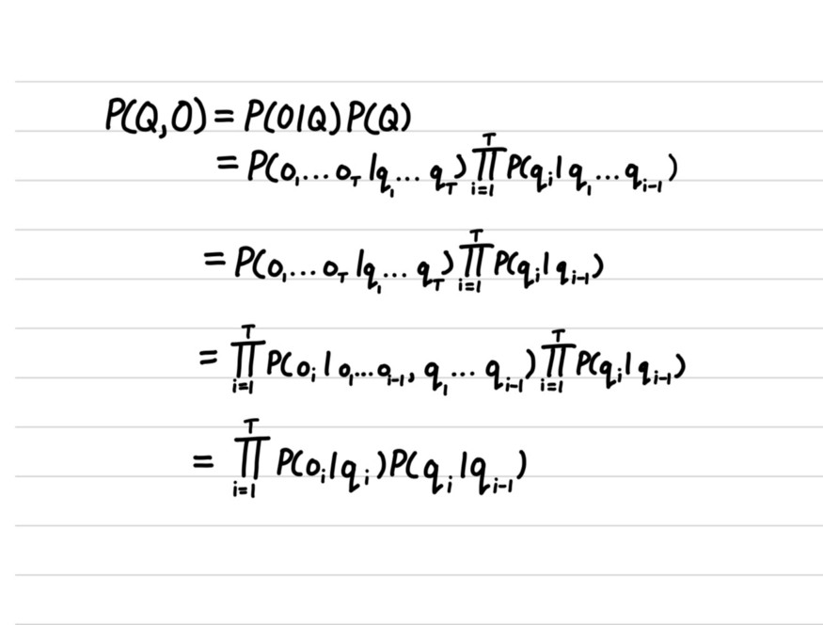
What is the Viterbi Algorithm?
The Viterbi Algorithm is a dynamic programming solution for finding the most probable hidden state sequence. If we have a set of states Q and a set of observations O, we are trying to find the state sequence that maximizes P(Q|O). By conditional probability, we can transform P(Q|O) to P(Q,O)/P(O), but there is no need in finding P(O) as P(O) does not pertain to changes in state sequences. We can just find the state sequence that maximizes P(Q,O). Let’s dive into the formula for P(Q, O).

Slide 5

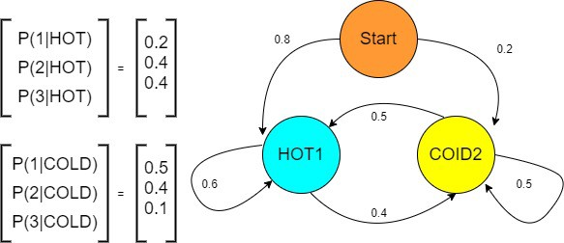
Transition and Emission matrix
Transition matrix | Hot (H) | Cold( C)
Hot (H) | 0.7 | 0.3
Cold( C) | 0.4 | 0.6
Initial probability :
hot = 0.8
Cold=0.2
0.4
COLD
Emission matrix | 1 | 2 | 3
Hot (H) | 0.2 | 0.4 | 0.4
Cold( C) | 0.5 | 0.4 | 0.1
0.7
0.6
0.3
0.2
0.4
0.4
0.5
0.4
0.1
1
2
3
1
2
3
For Emission states = 3,1,3
What is the hidden state sequence?

Slide 6
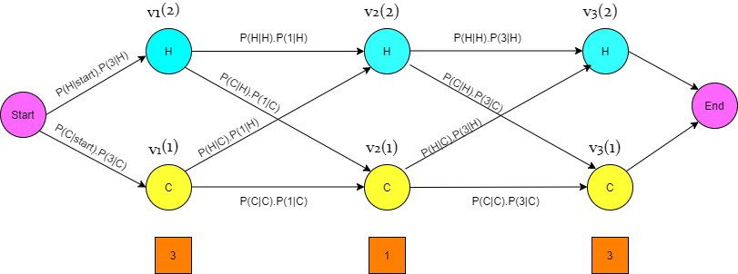
Transition matrix | Hot (H) | Cold( C)
Hot (H) | 0.7 | 0.3
Cold( C) | 0.4 | 0.6
Emission matrix | 1 | 2 | 3
Hot (H) | 0.2 | 0.4 | 0.4
Cold( C) | 0.5 | 0.4 | 0.1
0.14*0.32=0.0448
0.08*0.02=0.0016
0.28*0.0448=0.012544
0.8*0.4=0.32
0.16*0.048=0.00768
Joint probability
0.7*0.2=0.14
0.7*0.4=0.3=0.28
0.3*0.5=0.15
0.3*0.1=0.03
0.4*0.2=0.08
0.4*0.4=0.16
Ans: desired hidden sequence is H,C,H
0.2*0.1=0.02
0.6*0.5=0.3
0.6*0.1=0.06
0.15*0.32=0.048
0.3*0.02=0.006
0.06*0.048=0.00288
0.03* 0.0448 =0.001344

Slide 7
Note: T is the number of observations in the sequence.
So, if we wanted to find the state sequence to maximize P(Q, O), you could imagine this would be quite expensive as we would have to maximize P(Q, O) for all possible state sequences. This is where the Viterbi algorithm comes in. The Viterbi algorithm is an iterative approach to solving for the most likely sequence. Rather than finding the most probable hidden state sequence for all the observations, we just want to find the next most probable hidden state. We iteratively find the most probable states until we are done with the sequence of observations.

Slide 8
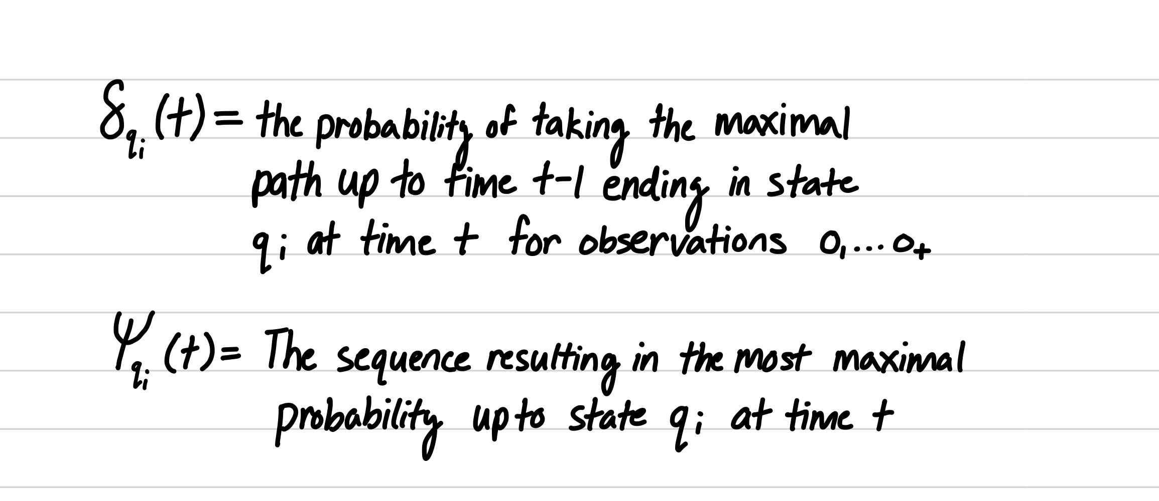
Steps of Viterbi algorithm (important)

Slide 9
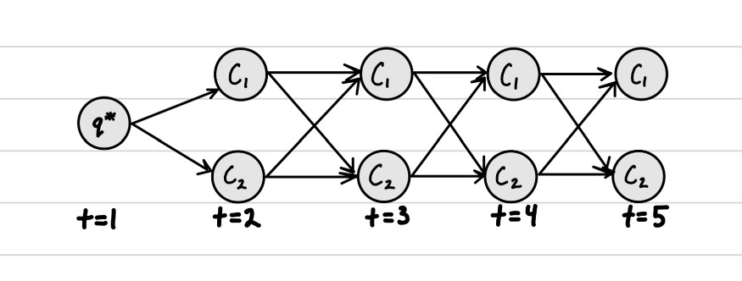
Head tail tail head

Slide 10
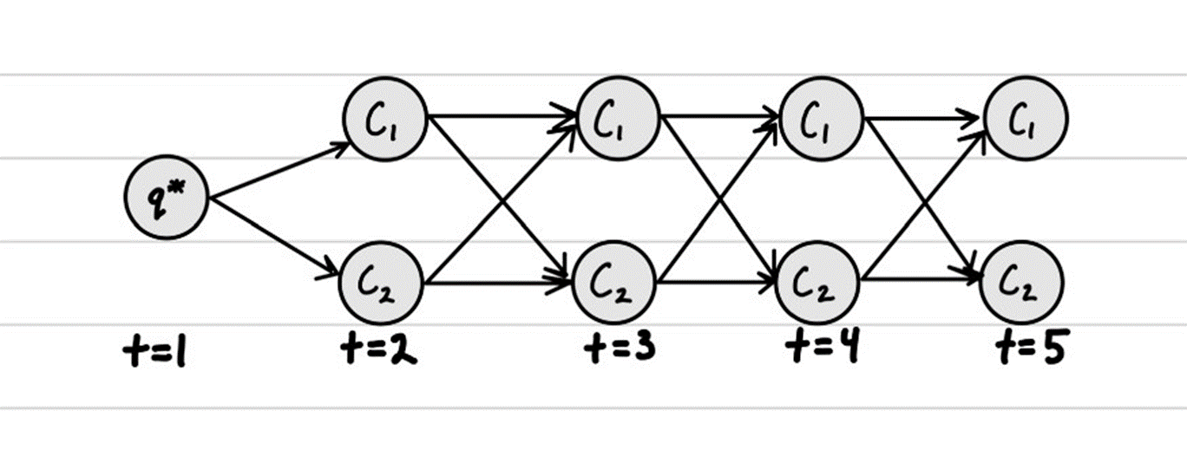
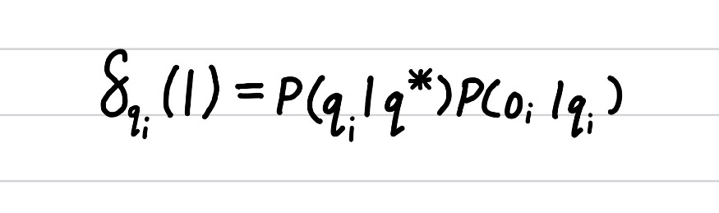
Step1: Initialization
We first create a start state q*. We then find the probabilities of the initial states and the observations given the initial states. In this case, P(qi|q*) is the probability that the start state is qi.
Head tail tail head

Slide 11
Head tail tail head

Slide 12
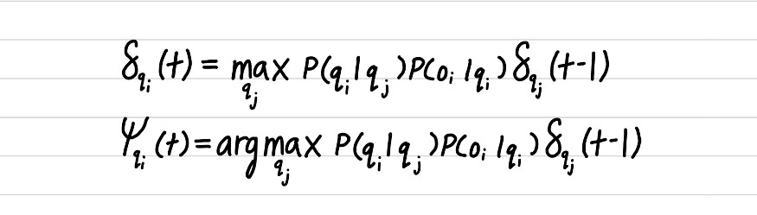
Step 2: Induction
We perform the induction step when t is greater than or equal to 2 and less than or equal to T where T is the number of observations + 1 (the plus 1 comes from the added start state). T represents to total number of observations.
Head tail tail head

Slide 13
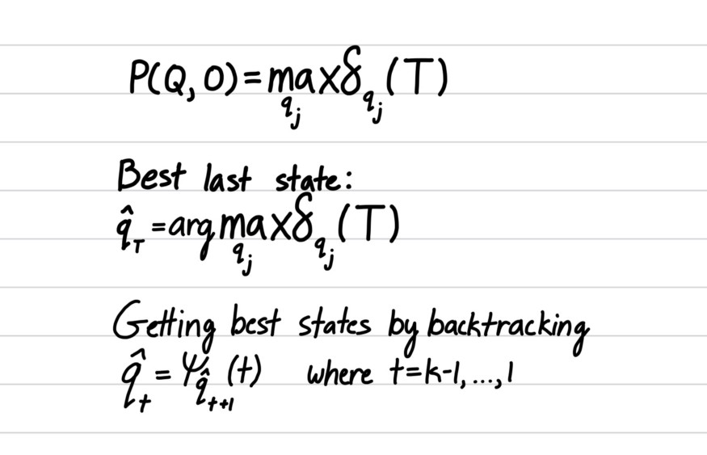
Step 3: Termination

Slide 14
Remember, in the induction step, we want to discover with the state at time t-1 maximizes the function. We do this by taking the state which maximizes the delta function. We do this with respect to all the states in our current time step. Here we see that the coin that maximizes the probability at time step 2 is coin 1 if we are in state coin 1 at time step 2, and coin 2 maximizes the probability if we are in state coin 2 at time step 2.

Slide 15
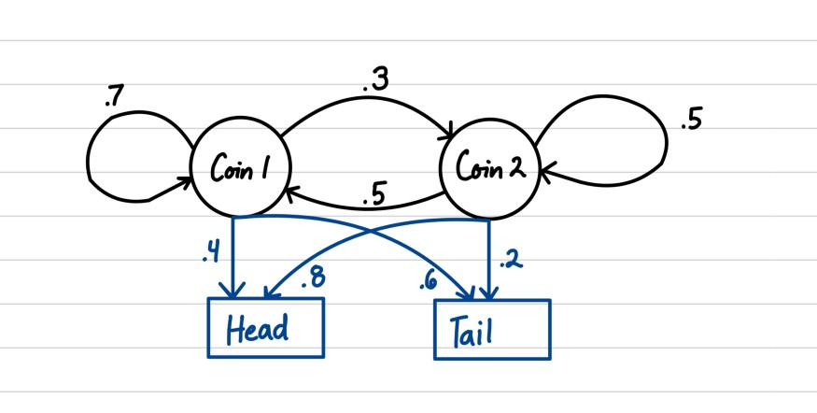
Another example
So, let’s go ahead and start finding the most probable hidden state sequence when we observed head, tail, tail, and head. I like to visualize the Viterbi algorithm using a trellis (the diagram found below).
Initial state
Coin1= 0.6
Coin2= 0.4

Slide 16
Head tail tail head

Slide 17
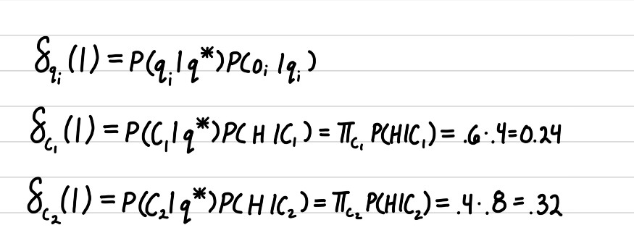
From the definition of the algorithm, we need to first initialize before we perform the induction step.
Initialization Step
Here we are calculating the probability of observing head at coin 1 and head at coin 2 at time step 1. Instead of user P(qi | q*), we use the initial state distribution. Now that we have initialized the function at time step 1, we can begin the induction step.

Slide 18

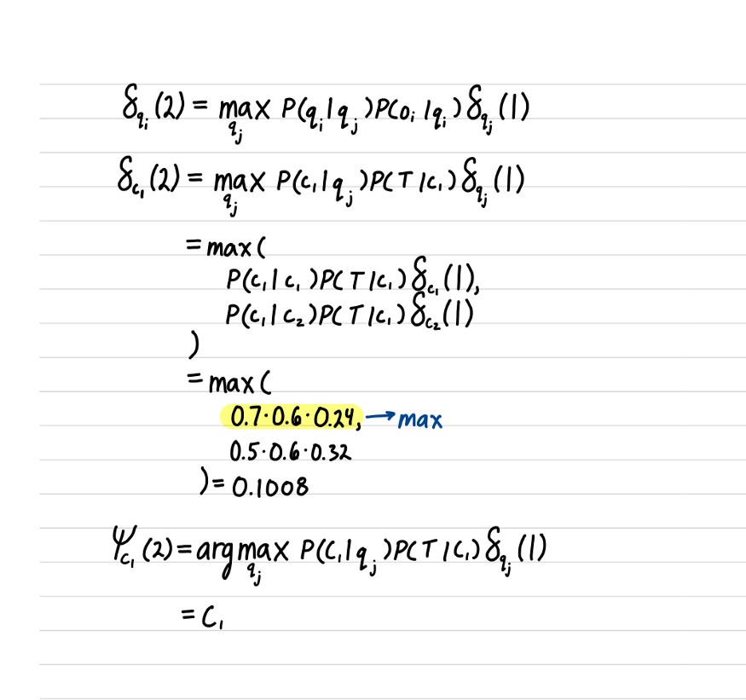
Induction Steps at time t=2
Head tail tail head

Slide 19

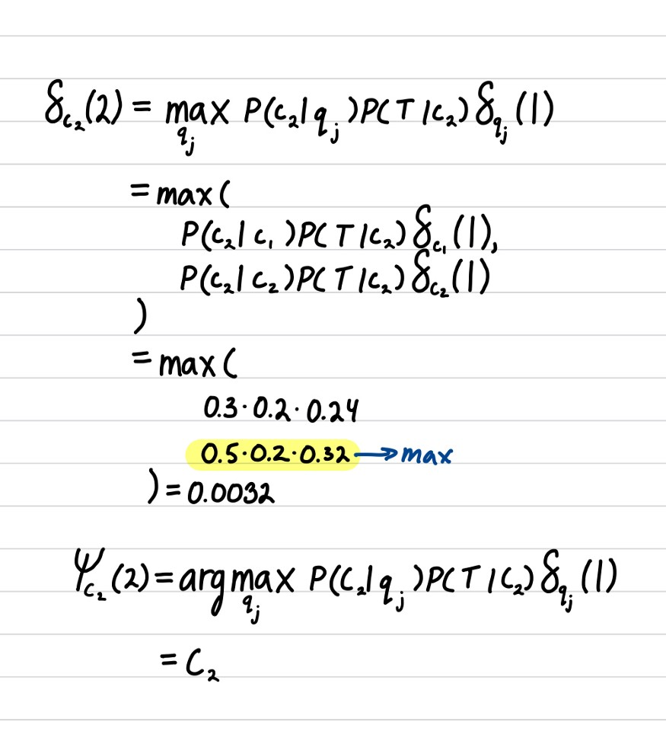
Head tail tail head

Slide 20
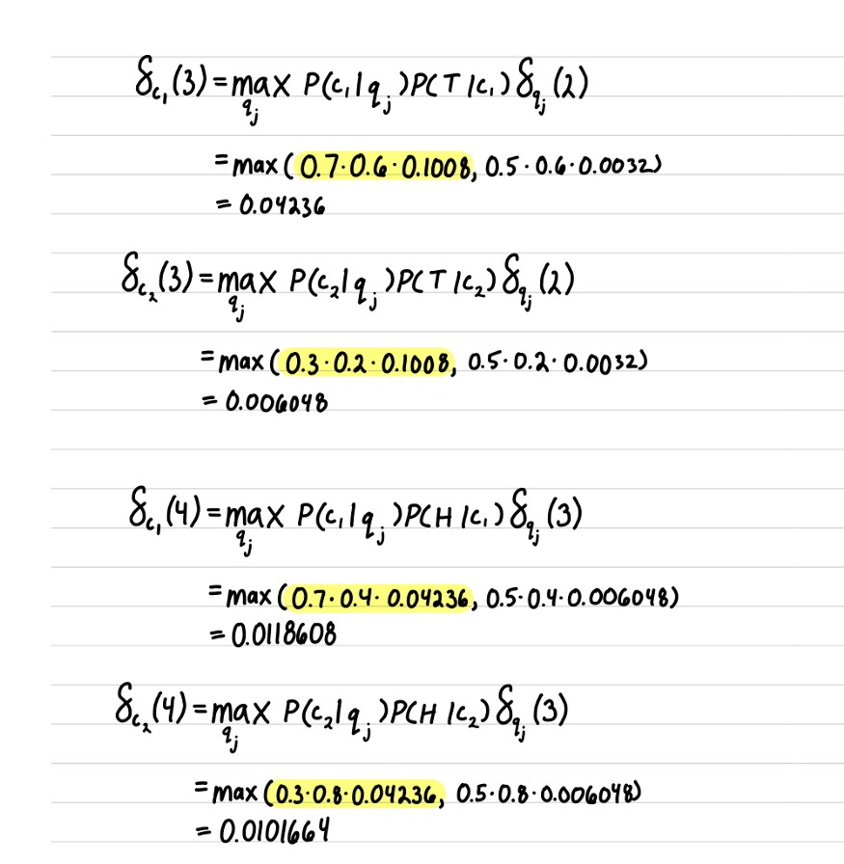
Head tail tail head

Slide 21
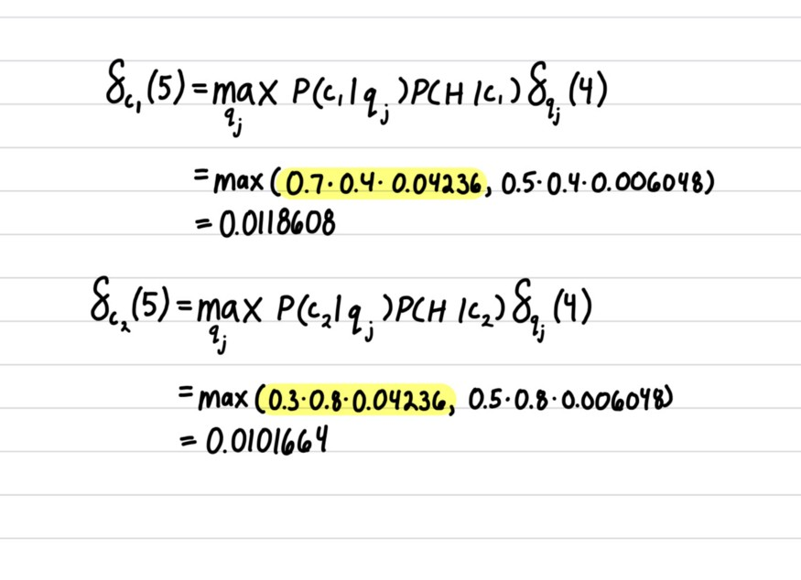
Head tail tail head
C1 C1 C1 C1

Slide 22
References
Hidden Markov Models with Viterbi Algorithm… | by shashika dilhani | Medium
Viterbi Algorithm | HMM | Solved Decoding Example - YouTube

